Slide 1

The impact on hardware resources and network performance when using network-based applications
Neil Sammut
Institute of Information & Communication Technology
MCAST, Paola, Malta
neil.sammut.e21620@mcast.edu.mt

Slide 2
Problem Definition
In today's IT landscape, users seek scalability, reliability, and cost effectiveness. Cloud computing provides a range of options to meet the needs of every user. However, ensuring performance efficiency is vital for day-to-day operations. Running multiple applications simultaneously can potentially impact not only hardware resources but also network performance.

Slide 3
Hypothesis & Questions
This project aims to determine the impact on the network performance and hardware resources when applications are running both individually and simultaneously.
It is expected that the more operating applications are running, there will be a corresponding increase in the demands placed on network and hardware resources which may possibly affect the smooth and fast operations of these applications.
I also aim to explore the impact that customizable features found in applications may have on the network and hardware resources and suggest ways on how to optimize them in order to attain an efficient hardware and network performance.
The Research Questions on which this project is based are:
What impact does running applications, both individually and concurrently, have on hardware resource utilization and network performance?
Does differing features for customization in applications effect the workload on network and hardware, and if affirmative what can be done to optimize network and hardware performance?
Notes:
Therefore, this research intends to focus on the recognition and catering of accents within the English spoken language and we hypothesise that…
To address the hypothesis, we ask these 3 research questions to identify the determining factors of accents and how ASR can be enhanced with our research

Slide 4
Literature
Previous studies conducted by by Javed et al, Popescu et al and Stantchev et al concentrate on the individual areas of network performance and hardware resources.
The main hardware resources affected by demand would be the:
CPU: Using a percentage of processing power in order to operate various programs in a device.
RAM: Using a significant amount of memory in order to temporarily store data for the CPU to process when running applications.
There are three types of Network factors:
Throughput: is the average amount of data that can be transmitted and received within a specific time frame, along with measuring the average rate of messages that are transmitted successfully to the relevant destination.
Bandwidth: Bandwidth is the actual amount of data, transmitted and received, within a specified timeframe, where the higher the bandwidth the more data is transmitted/received.
Latency: refers to the amount of time taken for data to be able to reach its destination after being sent, commonly referred to as delay.

Slide 5
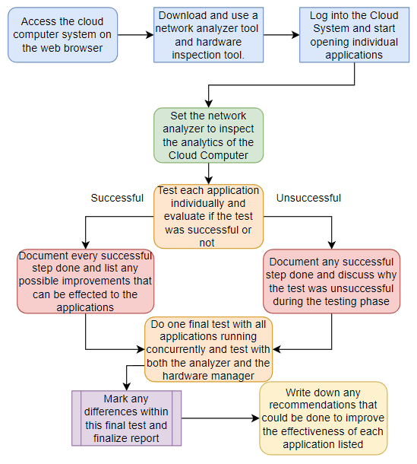
Workplan:

Slide 6
Methodology
Testing of inbuilt applications on a Synology NAS within a home network.
Four Application Systems:
Audio Server
Video Server
Web server
Virtual Machine Manager
The objectives that will be investigated in this research include:
a) Evaluate the difference between running one application at a time and running applications concurrently, to measure the network performance and hardware resources required in the running of these inbuilt applications.
b) Determine which application features can be utilized by the end user to have a minimal impact on the network and hardware resources, with the aim of enhancing the user experience by attaining optimal performance.

Slide 7
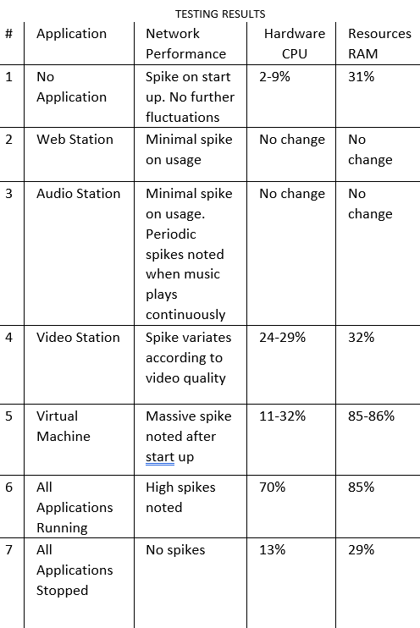
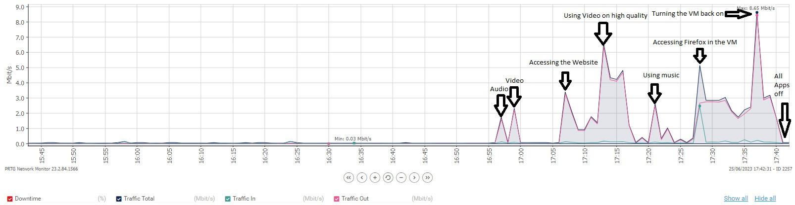
Results
Video showcasing the testing done on these applications: https://youtu.be/j07eqYFo2OI
On the left: The table demonstrates the results attained from all the tests.
On the bottom: The results of all the applications running simultaneously through the network graph.

Slide 8
Conclusions
A relationship was found between the operating features present in network-based applications and their impact on network performance and hardware resources. The utilization of enhanced features in applications (such as watching videos in high definition instead of standard definition) leads to an increase in demand for network and hardware resources.
When this testing was carried out by one end user the demand on network performance and hardware resources was much less than when multiple users used the system.
In this regard, further to previous studies conducted, it is essential to have a robust network infrastructure and high computing power to meet the demands of multiple users all operating simultaneously on the Cloud.

Slide 9
Future Recommendations
Future studies may consider testing network-based applications whilst changing:
Router parameters and performance (with wired or WiFi connections)
Increasing total RAM size

Slide 10
References
[1] Miller, Michael. Cloud Computing : Web-Based Applications That Change the Way You Work and Collaborate Online. Indianapolis, In, Que, 2009, www.researchgate.net/publication/234809538_Cloud_Computing_Web-Based_Applications_That_Change_the_Way_You_Work_and_Collaborate_Online. Accessed 26 June 2023.
[2] M. S. Bali and S. Khurana, “Effect of latency on network and end user domains in Cloud Computing,” 2013 International Conference on Green Computing, Communication and Conservation of Energy (ICGCE), Dec. 2013, doi: https://doi.org/10.1109/icgce.2013.6823539
[3] I. Sadooghi et al., “Understanding the Performance and Potential of Cloud Computing for Scientific Applications,” IEEE Transactions on Cloud Computing, vol. 5, no. 2, pp. 358–371, Apr. 2017, doi: https://doi.org/10.1109/tcc.2015.2404821.
[4] V. Stantchev, “Performance Evaluation of Cloud Computing Offerings,” 2009 Third International Conference on Advanced Engineering Computing and Applications in Sciences, Oct. 2009, doi: https://doi.org/10.1109/advcomp.2009.36.
[5] N. Khanghahi and R. Ravanmehr, Cloud Computing Performance Evaluation: Issues and Challenges, 5th ed., vol. 3. ResearchGate, 2013. Accessed: Jun. 24, 2023. [Online]. Available: https://www.researchgate.net/publication/270157682_Cloud_Computing_Performance_Evaluation_Issues_and_Challenges.
[6] U. Javed, M. Suchara, J. He, and J. Rexford, “Multipath protocol for delay-sensitive traffic,” IEEE Xplore, Jan. 01, 2009. https://ieeexplore.ieee.org/document/4808885 (accessed Jun. 24, 2023).
[7] D. Popescu, N. Zilberman, and A. Moore, “Number 914 Characterizing the impact of network latency on cloud-based applications’ performance,” 2017. Accessed: Jun. 24, 2023. [Online]. Available: https://www.cl.cam.ac.uk/techreports/UCAM-CL-TR-914.pdf

Slide 11
Thank you Neil Sammut, CSN6.2A

